Slide 1
Wifi Module
ESP-8266

Slide 2
What and Why Esp_8266
WHAT is ESp8266
The ESP8266 is a low-cost WiFi microchip, with a full TCP/IP stack and microcontroller capability.
It has 32 bit microcontroller.
32 kib instruction RAM.
Voltage range is 3.3V-3.6V
Wi-Fi version is 802.11b/g/n
Why Esp8266
We can use Ethernet shield but it needs a RJ45 connection to be connected to a router via CAT cables.
Esp8266 is cheaper than Ethernet shield.

Slide 3
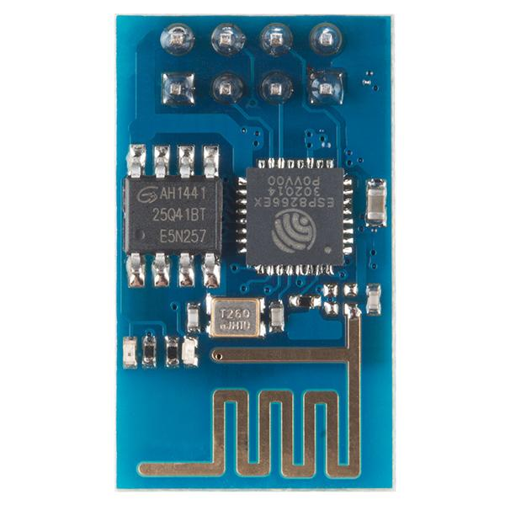
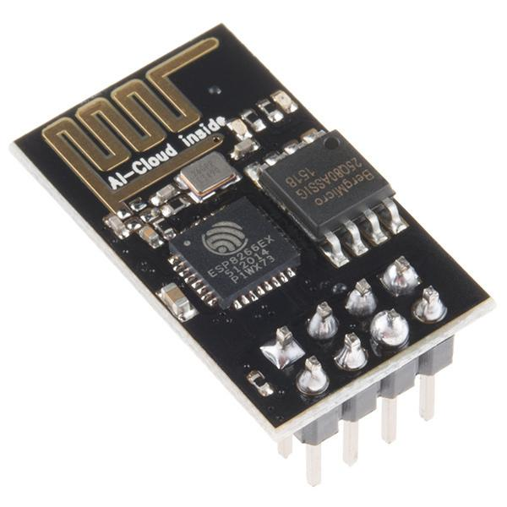

Slide 4
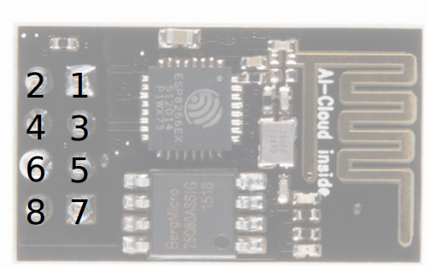
Pin Config of Esp_8266
1-GND
2-TX
3.GPIO2
4-CHPD
5-GPIO0
6-RESET
7-RX
8-VCC

Slide 5
AT commands
AT-Attention
AT+RST-Reset the board
AT+GMR-Firmware version
AT+CWMODE-Operating Mode
1.Client
2.Access point
3.Client and Access Point

Slide 6
AT+CWJAP=<wifi name><password> - Join network
AT+CWLAP- View available network
AT+CWQAP - Disconnect from network
AT+CWLIF - Show assigned IP address as access point
AT+CIFSR- Show assigned IP address when connected to network
AT+CIPCLOSE - Close socket connection
AT+CIPSTATUS - Show current status as socket client or server

Slide 7
Components
Arduino Uno
ESP8266 ESP-01
Breadboard
SparkFun Breadboard Power Supply Stick - 5V/3.3V
Male/Female jumper wire
Resistor 1k ohm

Slide 8
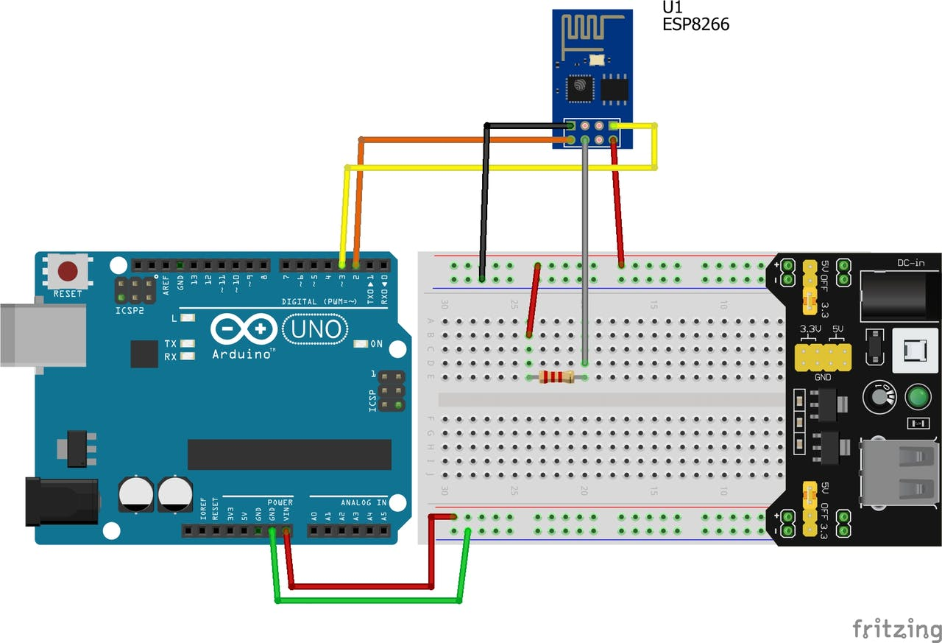
Connecting Esp_8266 to the internet using Arduino Uno
Step 1: Connection establishment between Esp and Arduino

Slide 9
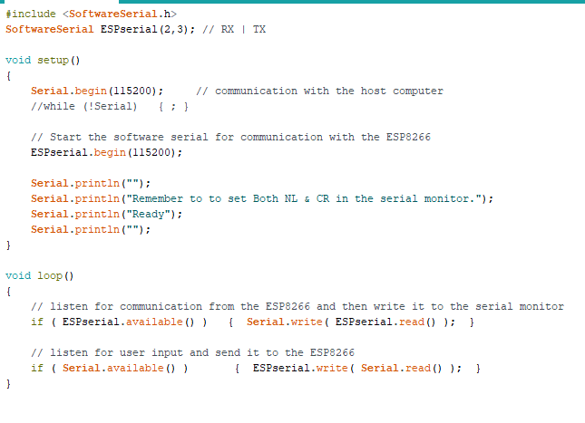
Connecting Esp_8266 to the internet using Arduino Uno
Step 2 : Uploading the code into Arduino

Slide 10
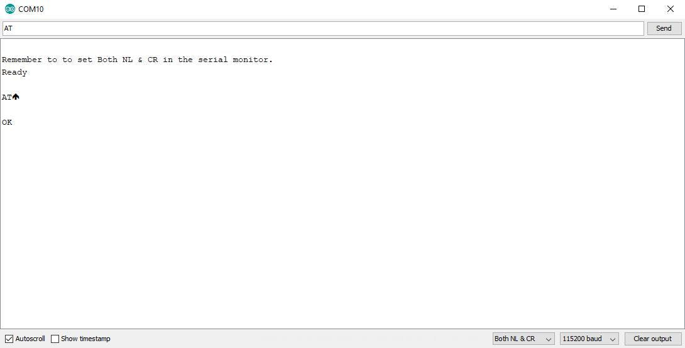
Connecting Esp_8266 to the internet using Arduino Uno
Step 3: AT commands
Command =AT

Slide 11
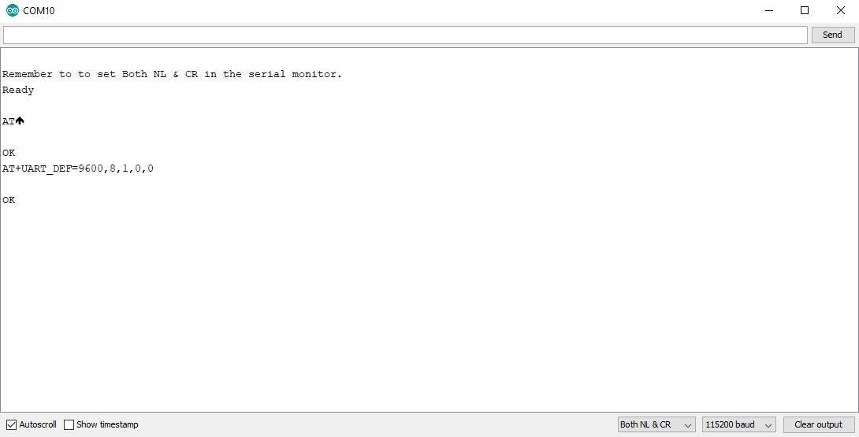
Connecting Esp_8266 to the internet using Arduino Uno
Command= AT+UART_DEF=9600,8,1,0,0

Slide 12
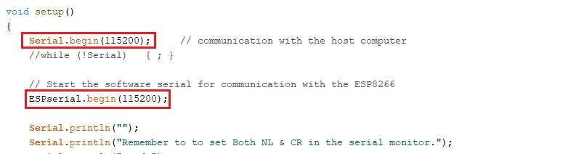
Connecting Esp_8266 to the internet using Arduino Uno
Change bouth rate to 9600 in Code and upload it again

Slide 13
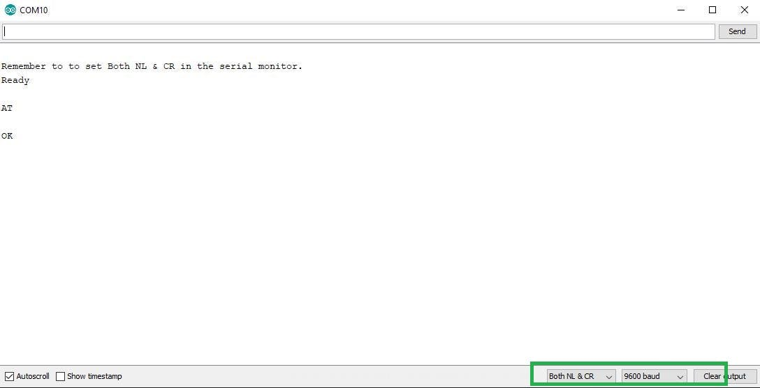
Connecting Esp_8266 to the internet using Arduino Uno
Close and serial monitor and give Command =AT

Slide 14
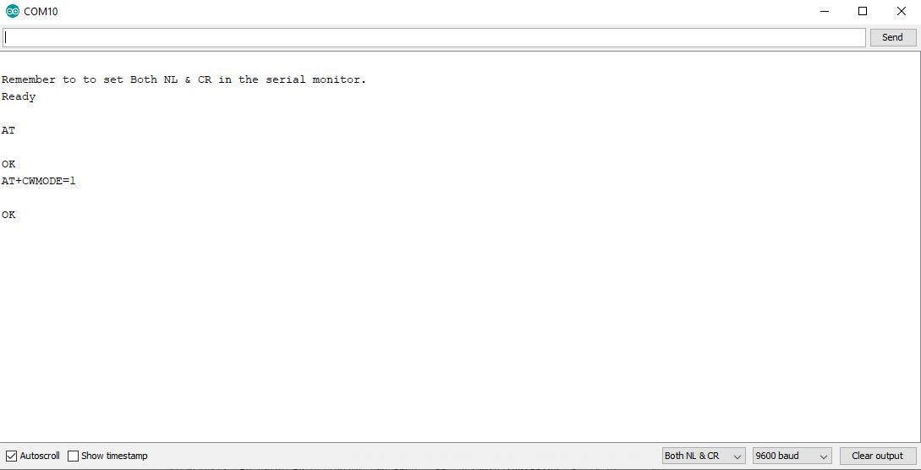
Connecting Esp_8266 to the internet using Arduino Uno
Command: AT+CWMODE=1

Slide 15
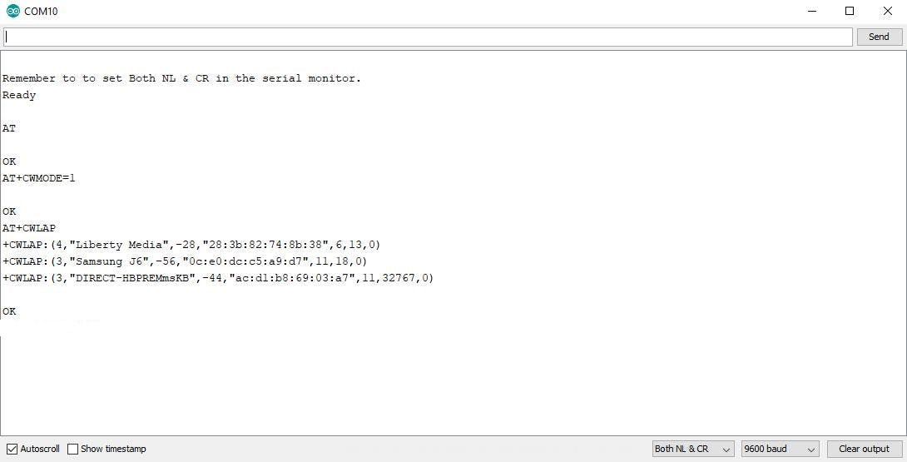
Connecting Esp_8266 to the internet using Arduino Uno
Command: AT+CWLAP

Slide 16
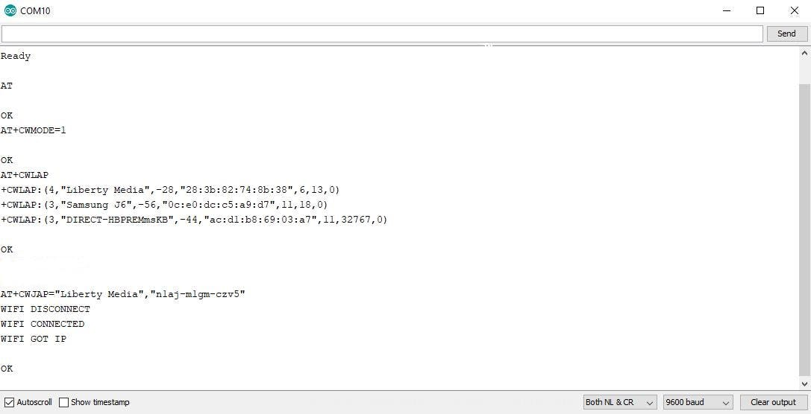
Connecting Esp_8266 to the internet using Arduino Uno
Command: AT+CWJAP="Liberty Media", "nlj-hyiyk187"

Slide 17
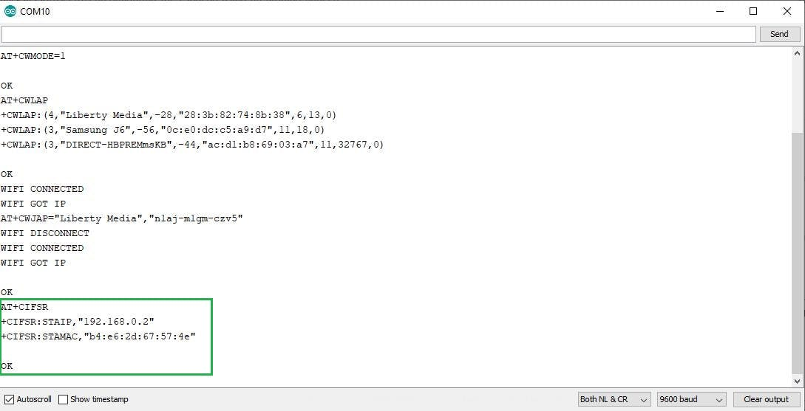
Connecting Esp_8266 to the internet using Arduino Uno
Command: AT+CIFSR

Slide 18
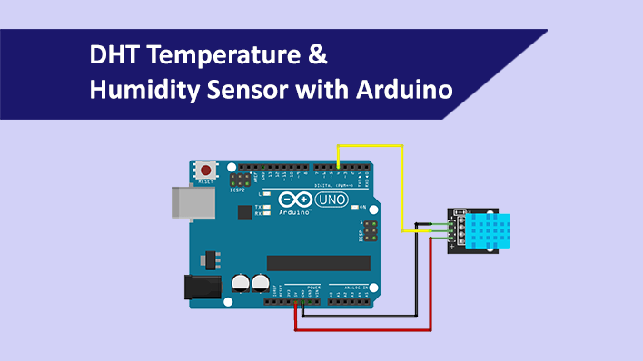
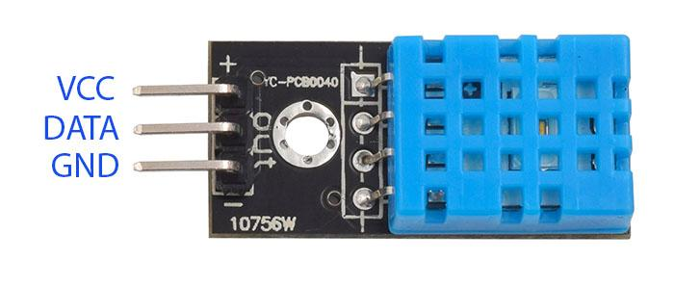
Sending Temperature and Humidity To ThingSpeak.com

Slide 19
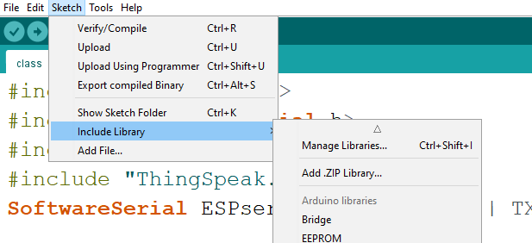
Steps to connect the required library

Slide 20
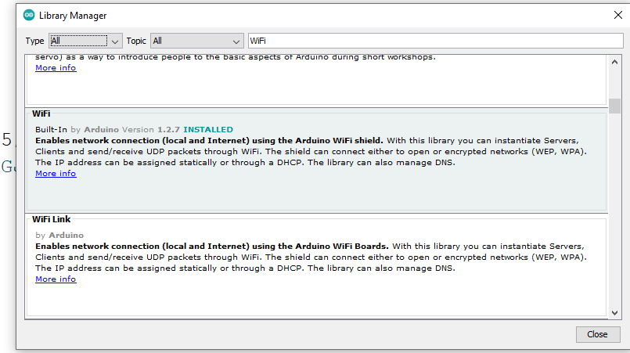

Slide 21
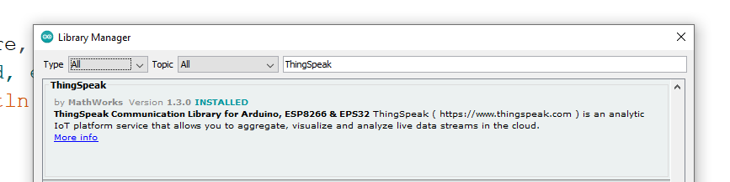

Slide 22
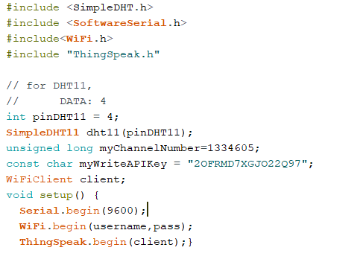
Code:

Slide 23
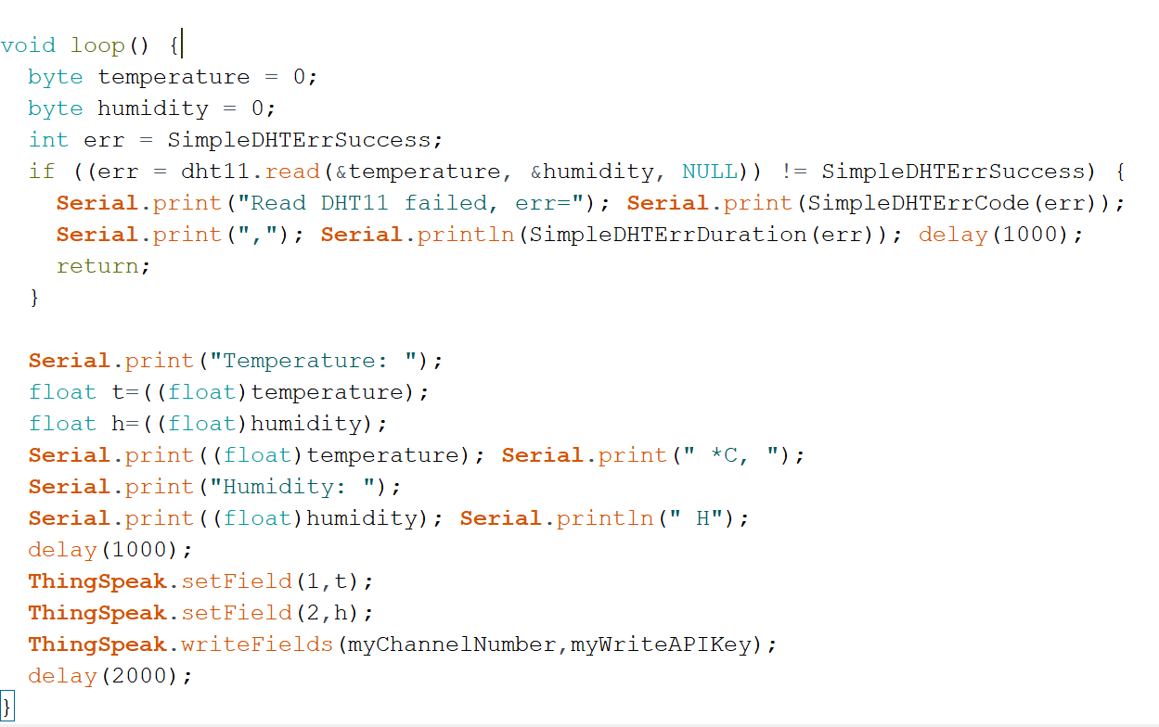

Slide 24

We cannot simulate Esp8266 in Proteus .

Slide 25

But we can simulate DHT11 in Proteus .

Slide 26
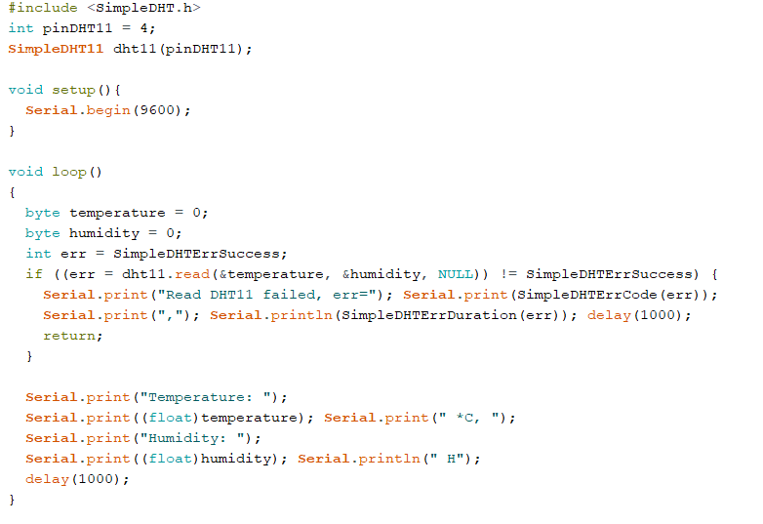
Code

